Slide 1
Trilce Estrada
Assistant Professor
Department of Computer Science
University of New Mexico
http://cs.unm.edu/~estrada

Slide 2
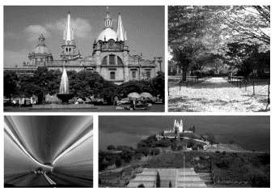
My Background
BS in Informatics from Universidad de Guadalajara, Mexico
MS in Computer Science from INAOE, Mexico
PhD from University of Delaware

Slide 3
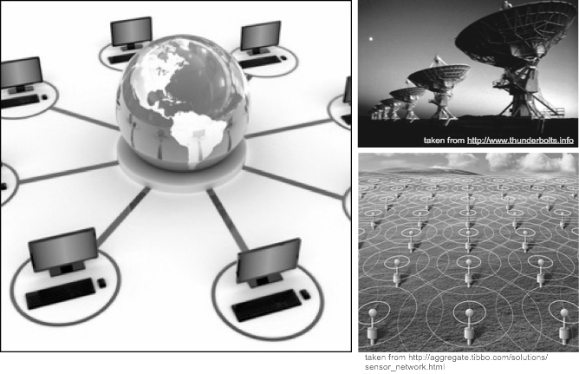
My Research
In-situ analysis, distributed learning, and data representation for scientific and medical applications

Slide 4
2009
CRAW Career workshop
CAREER?
Started this journey at the 2009 CRA-W Workshop on Career Planning
First time I heard of the CAREER, but what I heard was important:
It is not just about one project, it is about your research program
Teaching and research are both important, make sure to integrate them as best as possible

Slide 5
2009
CRAW Career workshop
CAREER?
Nov, 2012
Supercomputing
Work exposure
Participated at the SC12 Broader engagement program
Years later this would be important

Slide 6
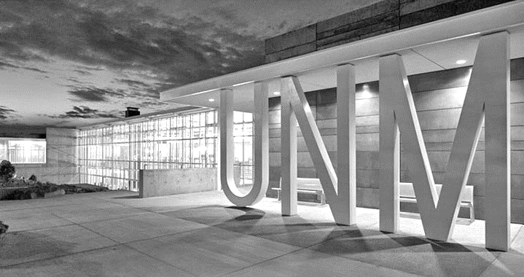
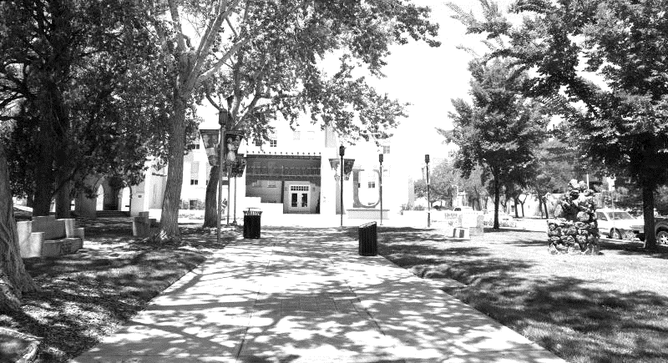
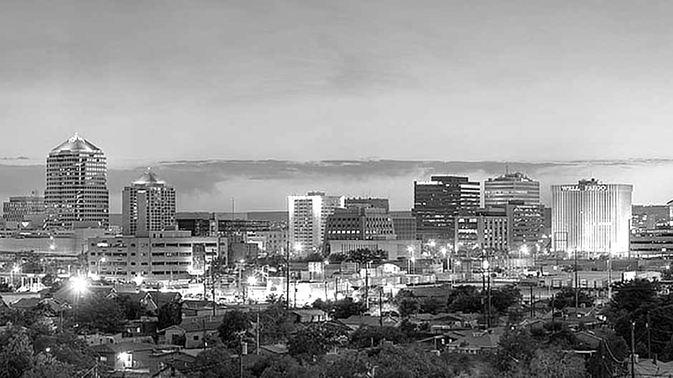
2009
CRAW Career workshop
CAREER?
Nov, 2012
Supercomputing
Work exposure
Aug, 2013
Joined UNM
Joined UNM
UNM is a Carnegie R1 and HSI/MSI
55.7% of the undergraduate students are from ethnic minority groups
Privileged closeness to SNL and LANL

Slide 7
2009
CRAW Career workshop
CAREER?
Participated at my first NSF panel
How are proposals structured?
What do reviewers discuss?
How easy is it to get your message lost in the minutiae?
How important it is to follow the solicitation?
What other things are useful to include?
Nov, 2012
Supercomputing
Work exposure
Aug, 2013
Joined UNM
Mar, 2013
First NSF panel
What is all this about anyway?

Slide 8
2009
CRAW Career workshop
CAREER?
Nov, 2012
Supercomputing
Work exposure
Aug, 2013
Joined UNM
Two things happened:
Saw my PhD advisor
Got energized
New ideas and problems
Mar, 2013
First NSF panel
What is all this about anywat?
May, 2014
IPDPS
Problems + Ideas

Slide 9
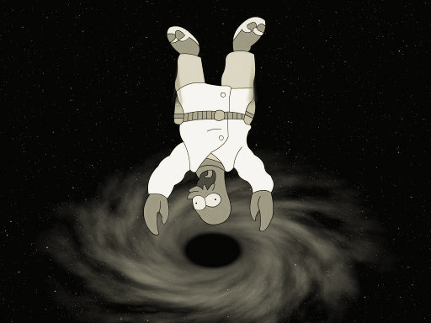
2009
CRAW Career workshop
CAREER?
Nov, 2012
Supercomputing
Work exposure
Aug, 2013
Joined UNM
Mar, 2013
First NSF panel
What is all this about anywat?
May, 2014
IPDPS
Problems + Ideas
June 01, 2014
OK, here we go!
But where exactly?
Ok, here we go!!
but where?

Slide 10
2009
CRAW Career workshop
CAREER?
Nov, 2012
Supercomputing
Work exposure
Figure out where do you fit in the current research landscape
Leverage your expertise
New direction, but not so new that you don’t have the expertise
Discuss with colleagues
Get examples of other proposals
Aug, 2013
Joined UNM
Mar, 2013
First NSF panel
What is all this about anywat?
May, 2014
IPDPS
Problems + Ideas
June 01, 2014
OK, here we go!
But where exactly?
Ok, here we go!!
but where?

Slide 11
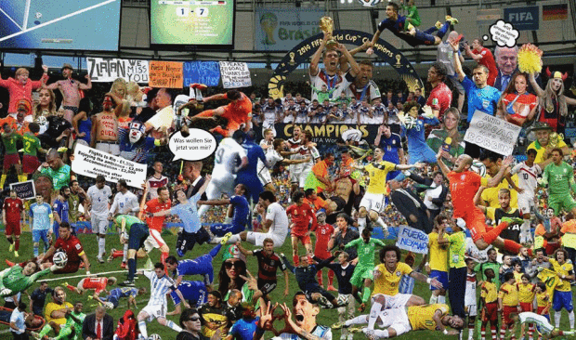
2009
CRAW Career workshop
World Cup 2014
CAREER?
Nov, 2012
Supercomputing
Work exposure
Aug, 2013
Joined UNM
Mar, 2013
First NSF panel
What is all this about anyway?
May, 2014
IPDPS
Problems + Ideas
June 01, 2014
OK, here we go!
But where exactly?
Jun 12, 2014
World Cup
Soccer + writing

Slide 12
2009
CRAW Career workshop
World Cup 2014
CAREER?
Nov, 2012
Supercomputing
Work exposure
Aug, 2013
Joined UNM
Mar, 2013
First NSF panel
What is all this about anyway?
May, 2014
IPDPS
Problems + Ideas
June 01, 2014
OK, here we go!
But where exactly?
Jun 12, 2014
World Cup
Soccer + writing
Focus and Motivation

Slide 13
2009
CRAW Career workshop
CAREER?
Identified the specific research challenges that I wanted to pursue
Identified specific outcomes and milestones
Identified a way to combine research and teaching with community involvement
Identified long term goals
Nov, 2012
Supercomputing
Work exposure
Aug, 2013
Joined UNM
Mar, 2013
First NSF panel
What is all this about anyway?
May, 2014
IPDPS
Problems + Ideas
June 01, 2014
OK, here we go!
But where exactly?
Jun 12, 2014
World Cup
Soccer + writing

Slide 14
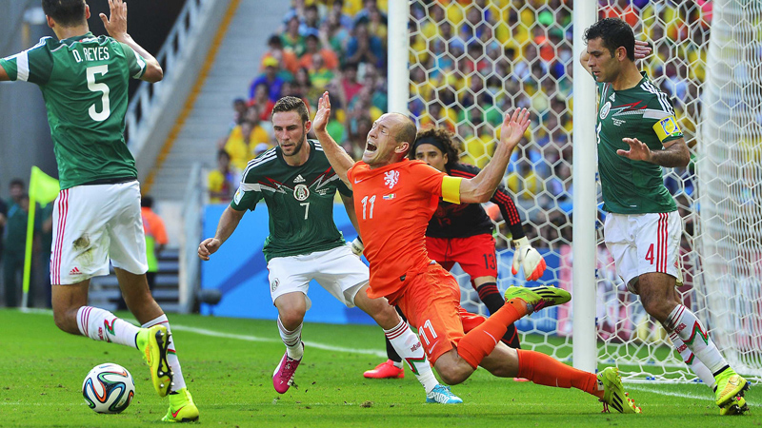
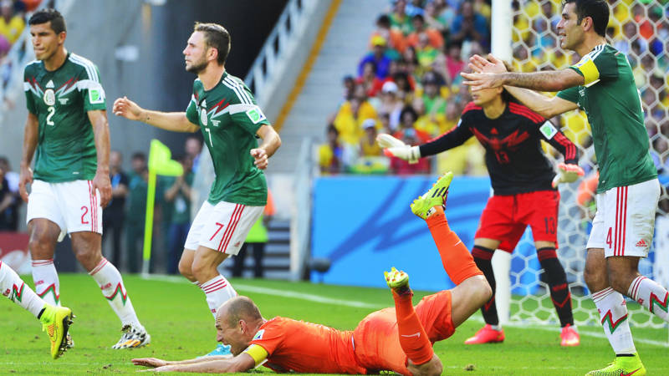
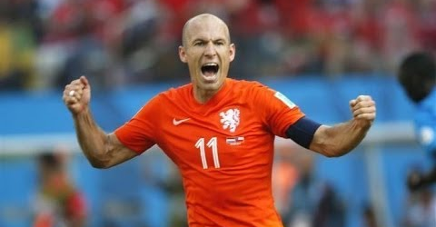
2009
CRAW Career workshop
CAREER?
Nov, 2012
Supercomputing
Work exposure
Aug, 2013
Joined UNM
Mar, 2013
First NSF panel
What is all this about anywat?
May, 2014
IPDPS
Problems + Ideas
June 01, 2014
OK, here we go!
But where exactly?
Jun 12, 2014
World Cup
Soccer + writing
Jun 29, 2014
Then this happened
Rethinking plan of action

Slide 15
2009
CRAW Career workshop
CAREER?
Rethink the plan of action: better organization
For each contribution:
Description
Evaluation and outcomes
Broader impact
Prior work
Nov, 2012
Supercomputing
Work exposure
Aug, 2013
Joined UNM
Mar, 2013
First NSF panel
What is all this about anywat?
May, 2014
IPDPS
Problems + Ideas
June 01, 2014
OK, here we go!
But where exactly?
Jun 12, 2014
World Cup
Soccer + writing
Jun 29, 2014
Then this happened
Rethinking plan of action

Slide 16
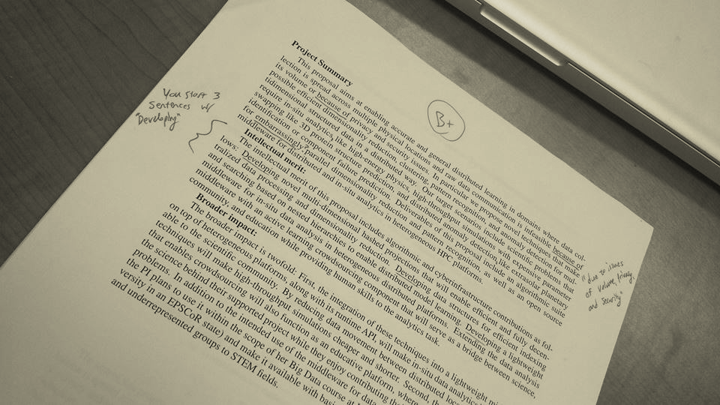
2009
CRAW Career workshop
CAREER?
Get feedback from both, senior and junior colleagues
Be more concrete
Give a quantitative example
Explain in plain terms why is this important
Nov, 2012
Supercomputing
Work exposure
Aug, 2013
Joined UNM
Mar, 2013
First NSF panel
What is all this about anywat?
May, 2014
IPDPS
Problems + Ideas
June 01, 2014
OK, here we go!
But where exactly?
Jun 12, 2014
World Cup
Soccer + writing
Jun 29, 2014
Then this happened
Rethinking plan of action
July,, 2014
First draft
So proud, but got grilled

Slide 17
2009
CRAW Career workshop
CAREER?
Final draft, submitted just hoping to get initial feedback
To contact or not to contact NSF Program Director?
Nov, 2012
Supercomputing
Work exposure
Aug, 2013
Joined UNM
Mar, 2013
First NSF panel
What is all this about anywat?
May, 2014
IPDPS
Problems + Ideas
June 01, 2014
OK, here we go!
But where exactly?
June 12, 2014
World Cup
Soccer + writing
June 29, 2014
Then this happened
Nov, 2012
Supercomputing
Rethinking plan of action
Work exposure
July, 2014
First draft
So proud, but got grilled
A few hours before the deadline
Final draft
Yayy!!

Slide 18
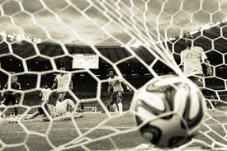
2009
CRAW Career workshop
CAREER?
Final draft, submitted just hoping to get initial feedback, got funded!!
Fight for each ball, you never know what might happen if you try
Nov, 2012
Supercomputing
Work exposure
Aug, 2013
Joined UNM
Mar, 2013
First NSF panel
What is all this about anywat?
May, 2014
IPDPS
Problems + Ideas
June 01, 2014
OK, here we go!
But where exactly?
June 12, 2014
World Cup
Soccer + writing
June 29, 2014
Then this happened
Rethinking plan of action
July, 2014
First draft
So proud, but got grilled
A few hours before the deadline
Final draft
Yayy!!

Slide 19
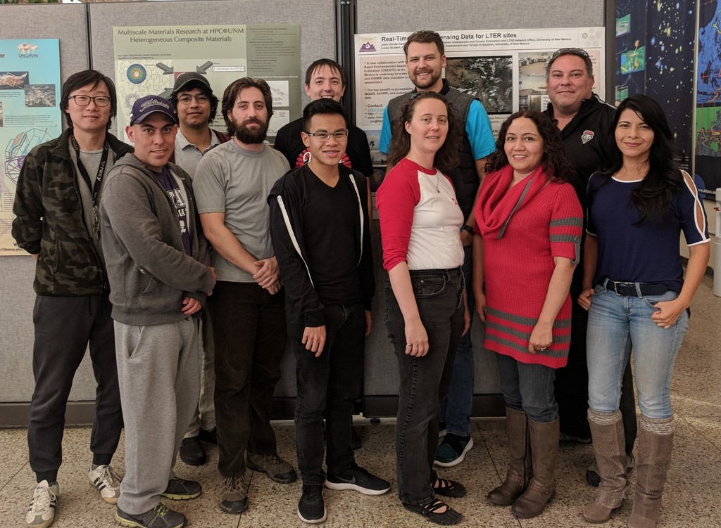
Questions?
trilce@unm.edu

