Slide 1
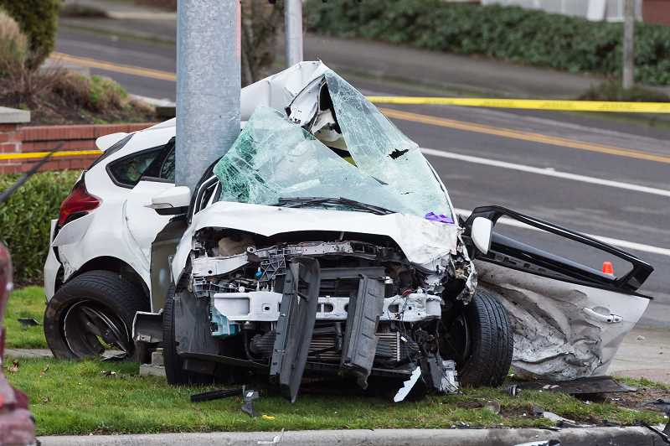

Top Ten Mistakes to Avoid in Writing CAREER Proposals
CISE Mixed Advisory Taskforce on Technology,
Education, Research and Science (CISE MATTERS)

Slide 2
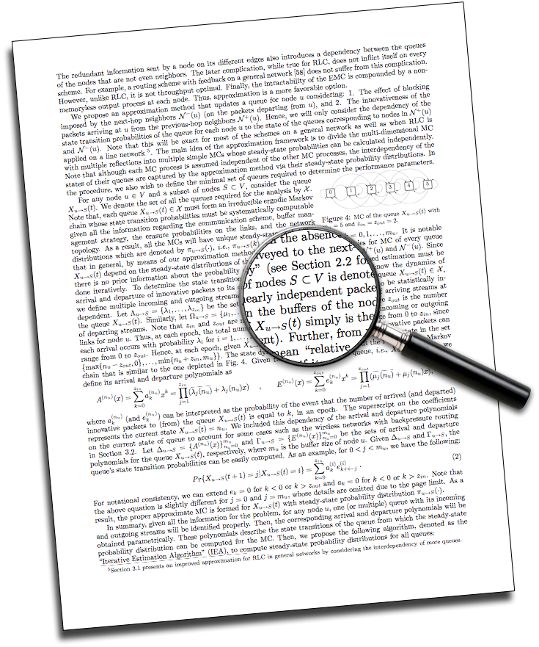
Number 10: Fonts Too Small
Small fonts promote reader fatigue
Reviewers DISLIKE small fonts
PAPPG mandates:
  11 point font minimum
  1 inch margins
  6 lines max per vertical inch

Slide 3
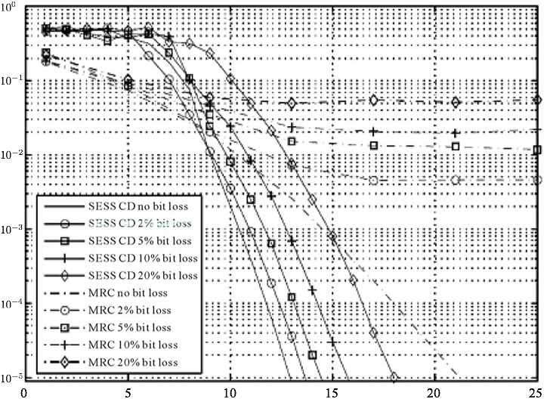
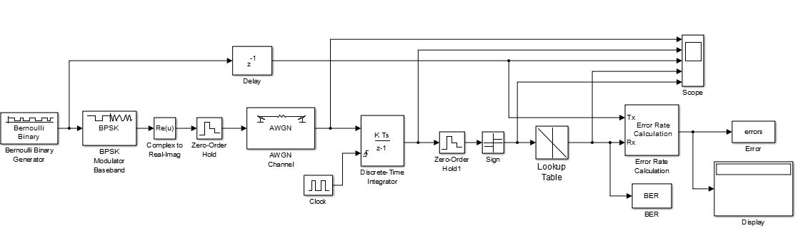
Number 9: Figures Illegible
Avoid “crowded” visuals
Don’t assume reader will print in color
Use vector graphic formats

Slide 4

Number 8: Acronyms and Abbreviations
Acronyms constitute a private language that excludes the reader.
Acronyms are often cryptic, and make text hard to read.
Reader will NOT memorize your abbreviations!

Slide 5
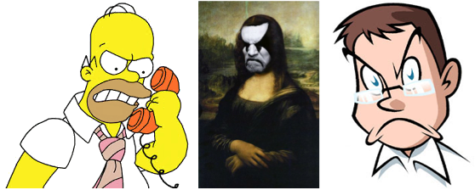
Number 7: Dissing the Competition
Good idea: Citing others’ work
Bad idea: Slighting others’ work
(“Others’ work” might be sitting on the panel)

Slide 6

Number 6: Poor distinction between preliminary results and proposed work
Make a clear demarcation
Distinguish your results from others’
Identify obstacles you anticipate
Highlight what you bring to the table

Slide 7
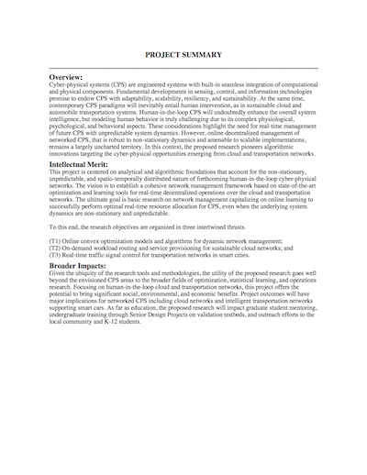
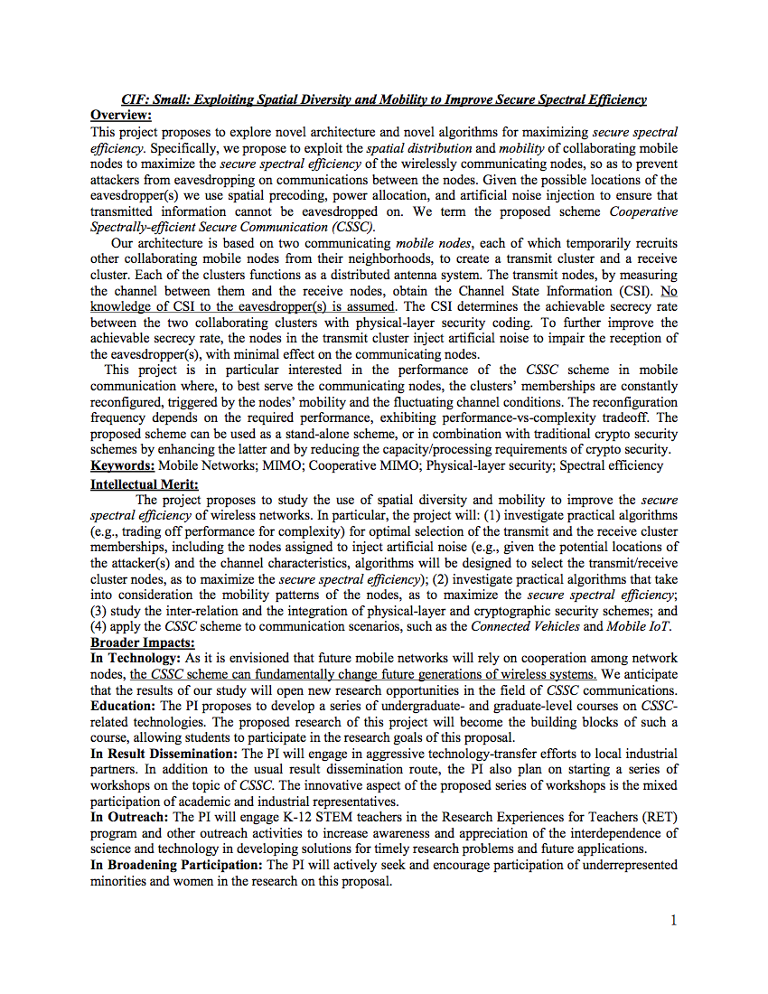
Number 5: Misleading Project Summary
Good
Fair

Slide 8



Number 4: Lackluster Education Plan
Should be integrated with research plan
Think beyond your present teaching duties

Slide 9

Number 3: “It wasn’t clear …”
Symptoms:
Long-winded explanations
Too many superfluous details
Poor organization of thoughts into words
Remedies:
Use fewer words
Read first two pages aloud
“Make every word tell”

Slide 10

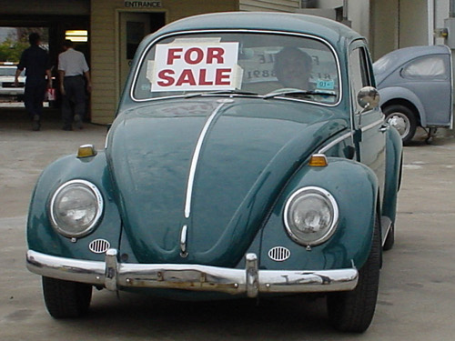

Number 2: Confining yourself to your PhD work
CAREER proposal should be forward-looking
Move above and beyond your PhD work
“Imagine a world …”
(yes)
(no)

Slide 11
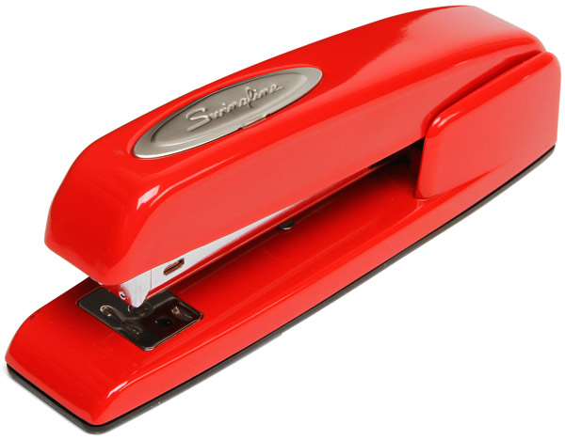


Number 1: Research Plan lacking Cohesion
Don’t staple together unrelated ideas
Don’t offer a laundry list with no prioritization
Don’t make everything look like a nail to your one hammer
Tell a story with your narrative

Slide 12

Questions?

