Slide 1
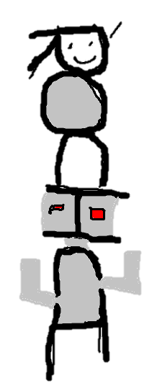
NSF CISE CAREER WORKSHOP 2019
M. Ehsan Hoque
Assistant Professor
Rochester Human-Computer Interaction Group
(ROC HCI)
University of Rochester
Twitter: @ehsan_hoque

Slide 2
My Background
Affiliation:
Assistant Professor of computer science at the University of Rochester
Interim Director of Goergen Institute for Data Science
Ph.D. from MIT in 2013
Research:
Work in the intersection between AI and HCI
Publish in UbiComp, IUI, FG, AAAI
Reviewing experience:
Served on five NSF panels so far
Regular reviewer of ARO proposals

Slide 3
How many times did I apply for CAREER?
1
2
3

Slide 4
How many times did I apply for CAREER?
1
2
3

Slide 5
Experience in grant writing
Applied to NSF CRII 2014
CHS, granted
Applied for NSF CAREER in 2015
CHS and RI, denied
Re-applied for NSF CAREER in 2017
CHS, granted
Current active grants
DARPA
ARO
NIH
Google

Slide 6
NSF CAREER Reviews
Unsuccessful
Successful
R1: Very good
R2: Very good
R3: Good
R1: Excellent
R2: Good
R3: Good
Proposal 1
Proposal 2

Slide 7
Unsuccessful case
Super ambitious and vague
One and half page of generic education plan
Successful case
Ambitious with exact steps and early results
4 page of unique education plan

Slide 8
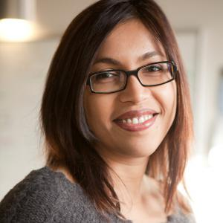
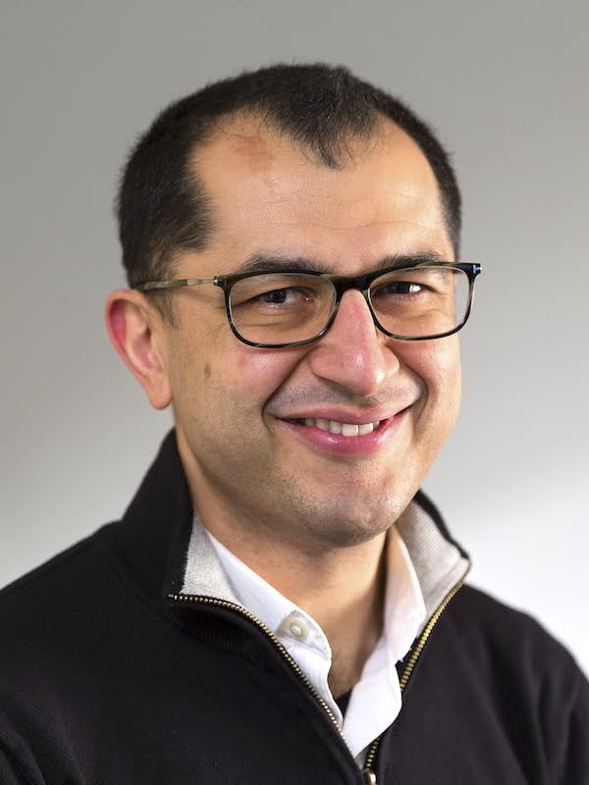
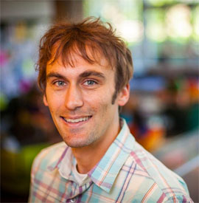
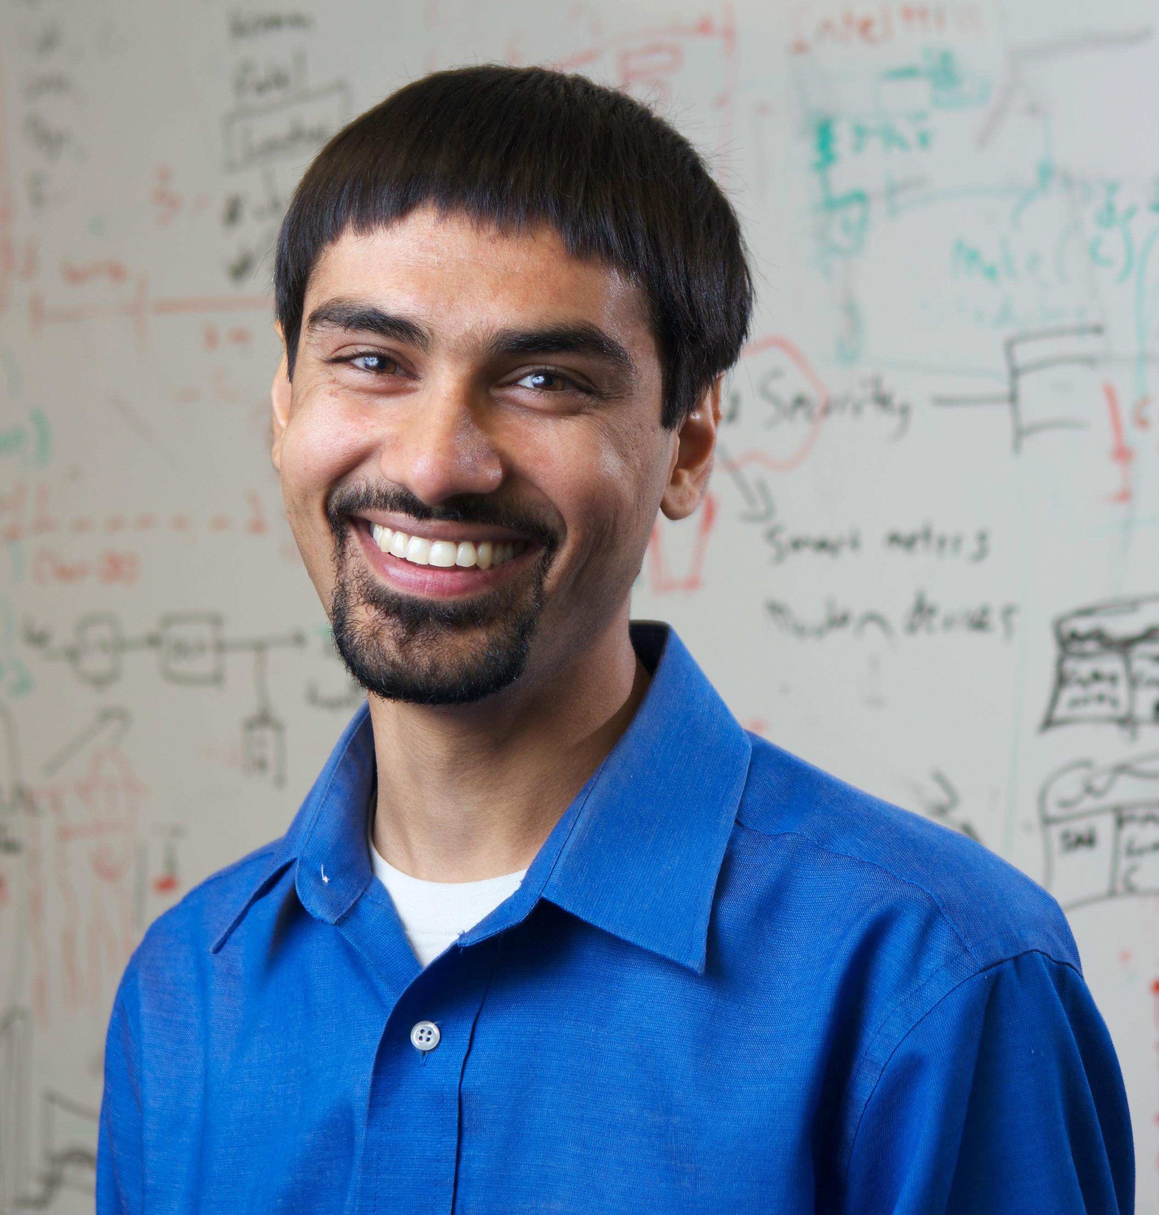
Samples of other CAREER awardees
Tanzeem Choudhury
(2009)
Bilge Mutlu
(2011)
Jeff Bigham
(2012)
Shwetak Patel
(2013)
“Behavior modeling”
“Human-robot interaction”
“Crowdsourcing and accessibility”
“Sustainability sensing”

Slide 9
Education component
You can’t write it in a day or two
Needs several weeks
What’s an excellent education component?
The component is unique to you

Slide 10
How do I write a proposal?
Put myself on the shoes of a reviewer
Spend half of my time on the summary
Consistency in budget, data management plan, letter of support
Use accessible language and avoid technical jargons

Slide 11
Interaction w/ Program Director
CRII 2015
CAREER 2015
CAREER 2017

Slide 12
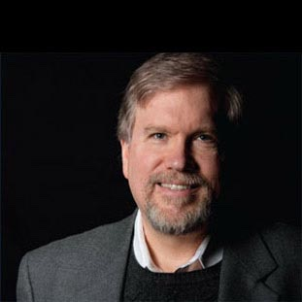
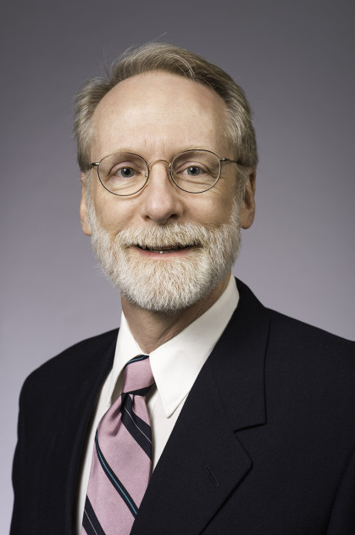
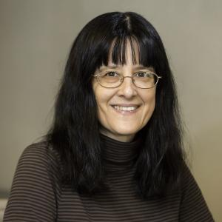
Mentorship
Len Schubert
Henry Kautz
Michael Scott
Sue Fussel
SIG DIAL
AAAI
SIG ARCH
SIG CHI

