Slide 1
Glencora Borradaile
Associate Head for Graduate Programs
Associate Professor
School of Electrical Engineering and Computer Science
Oregon State University

Slide 2
Research Proposals to NSF CCF
CCF Medium
Solutions to Planar Optimization Problems 2010-2013
CAREER
Understanding and advancing network design in planar domains 2013-2018
CCF Small
Efficient Algorithms for Cycles on Surfaces 2016-2019
panel
panel
panel
panel
panel
TT starts
2009
Tenure
2015
CAREER
Network design problems in planar and related domains 2012 (rejected)
CCF Medium
Efficient Algorithms for Cycles on Surfaces 2015 (rejected)

Slide 3
First CAREER Proposal
Thought of what I could do that would make me famous.
Explained what that is and why it would make me famous.
Explained why I could plausibly do it.
Describe lower-hanging fruit that would point me in the direction of the famous-making fruit.

Slide 4
From rejection to award
Listen to the reviewers.
Start on the work you proposed anyway.
Get feedback.
List suggested reviewers.

Slide 5
Listen to the reviewers
intro
& setup |  | low
 |  | hanging
 |  | fruit
famous | making | fruit | education | prior support
 |  |  | & BI
“...the proposal could have made a stronger case that these problems are fundamental, and techniques for solving them would extend to large classes of problems.”
First submission

Slide 6
Listen to the reviewers
famous |  | intro
making | low-hanging fruit
fruit |  | low
 |  | hanging
 |  | fruit | BI &
 |  |  | education | prior support
“...the proposal could have made a stronger case that these problems are fundamental, and techniques for solving them would extend to large classes of problems.”
Second submission

Slide 7
Listen to the reviewers
“At times the proposal reads more like a survey paper than a research proposal, where it is not clear whether an open problem is being identified, or a proposed solution, or just background.”

Slide 8
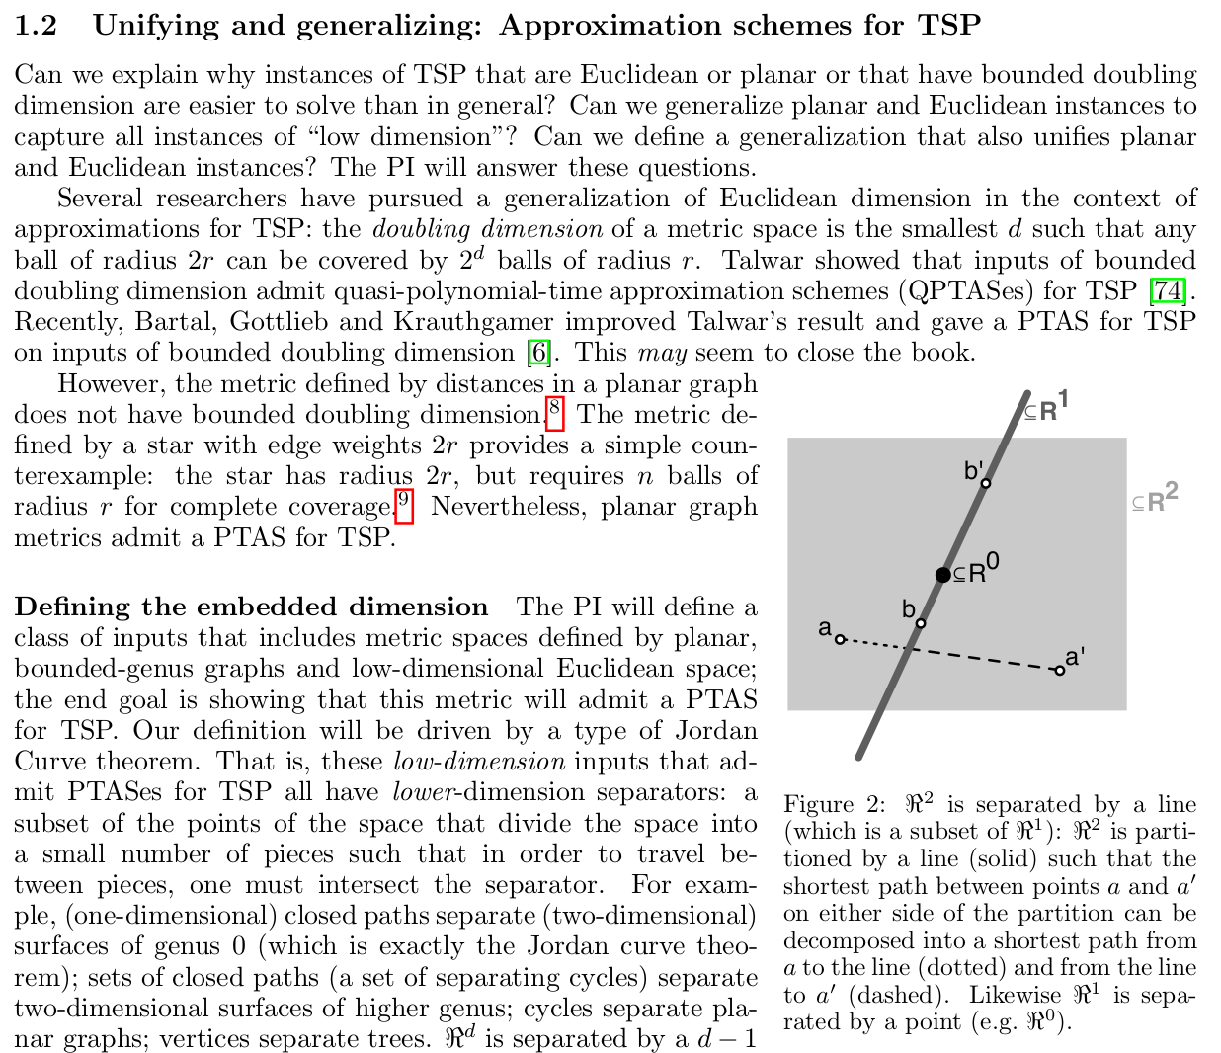
Listen to the reviewers
\usepackage{subfigure,wrapfig}
\linespread{0.901}
\usepackage[small]{caption}

Slide 9
2. Start on the work you proposed
“The PI with a colleague has already given evidence that this approach is promising as she shown … ”

Slide 10
3. Get feedback
From “tenure letter writers” (want you to succeed, but aren’t collaborators).
For meaningful feedback, give them at least 6 weeks.
Give yourself at least 2 weeks to use their feedback.
So that means: an unembarrasing draft by 2 months before the deadline ...

Slide 11
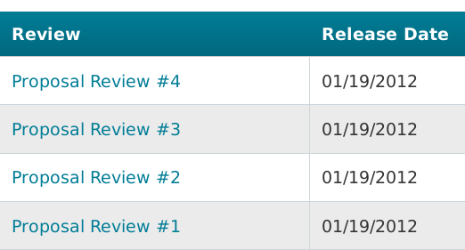
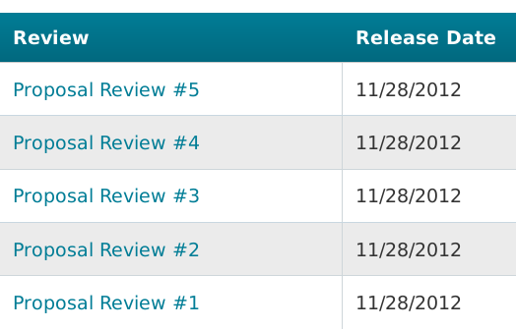
4. List suggested reviewers
“Tenure letter writers”
Maybe they will provide an ad hoc review that will make a compelling case that could sway the panel ...

Slide 12
Education plan & BIs
First submission: “The broader impact component of the proposal is excellent and shows that the PI strongly cares about teaching, mentoring, and outreach.”
Second submission: ensured education plan supported the research and weren’t just “tacked on”.
$500K supports 2 PhD students: “The two main goals of the project will become the basis of two Ph.D. students’ theses.”
Just as for research, give evidence that you can do this part.

Slide 13
Thanks!
… and good luck!

